Slide 1


Earth surface Temperature
IE 6600: COMPUTATION AND VISUALIZATION
Team 6
ATHARVA UPLENCHWAR
HARSHADA TERWADKAR
HOLIN LEE
MANTHAN GADHIKAR
NEERAJ KULKARNI
PARAG JAIN

Slide 2
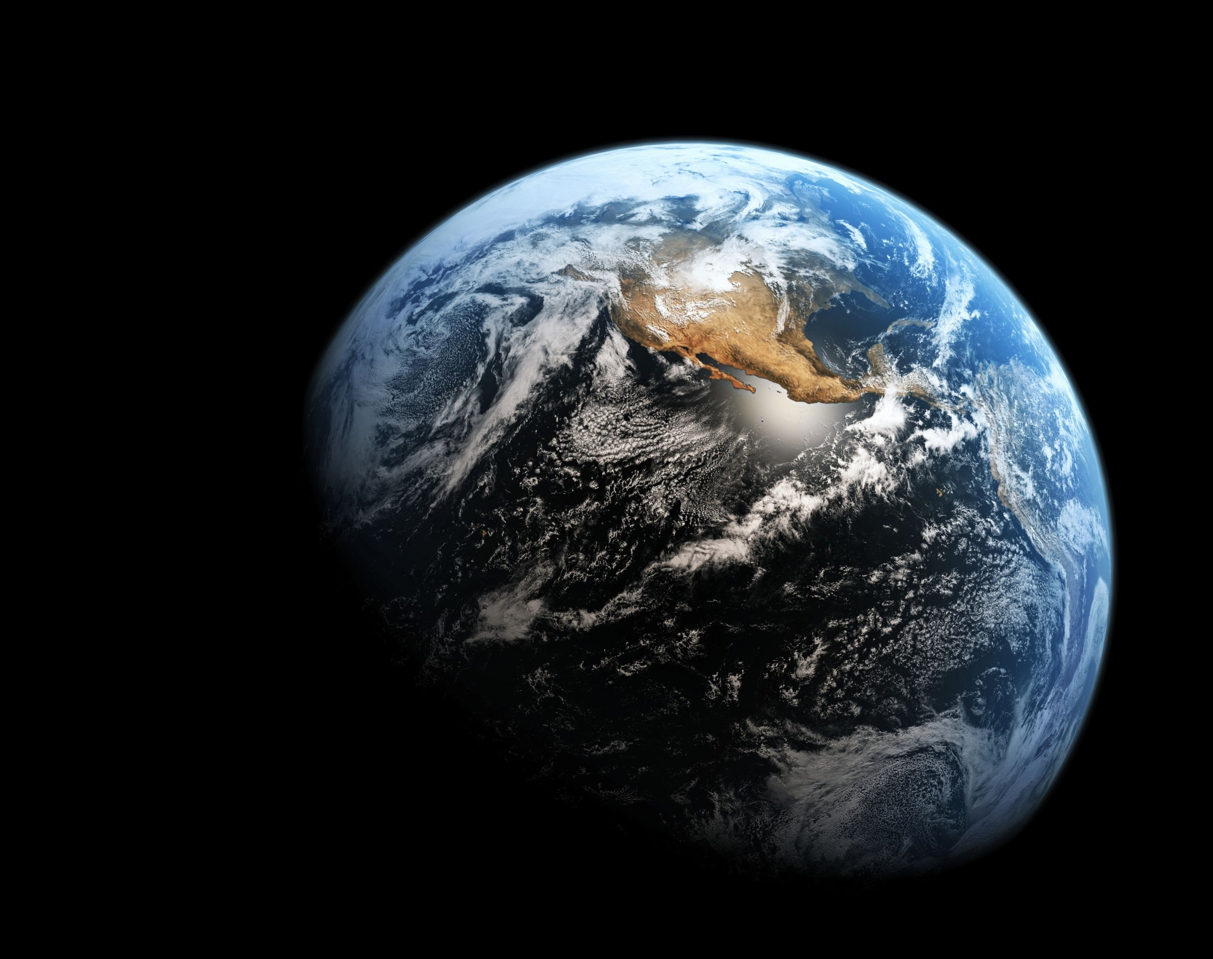
Background
Climate change is the biggest threat to mankind
Temperature plays important part in shaping weather patterns, guiding the life cycle of various organisms and maintaining ocean levels.
Earth’s temperature has risen by an average of 2° C
The rate of warming since 1981 is more than twice as fast 0.18° C
Earth surface temperature is the essential parameter in weather prediction and earth climate system.

Slide 3

Effects of increasing earth surface temperature
A warmer climate creates an atmosphere that can collect, retain, and unleash more water, changing weather patterns in such a way that wet areas become wetter and dry areas drier.
Rising earth surface temperatures affect glaciers, ice sheets, permafrost, and the vegetation in Earth’s ecosystems.
Increases in land surface temperature also have serious health implications for humans.
Scientists have claimed that climate change is the biggest global health threat of the 21st century.

Slide 4
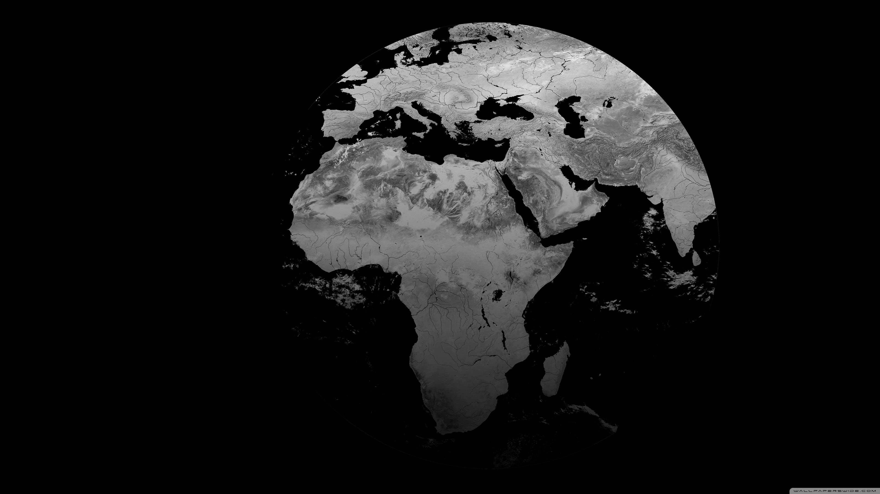
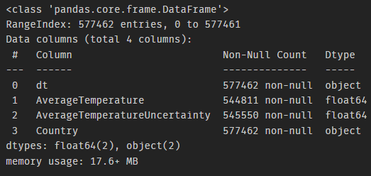
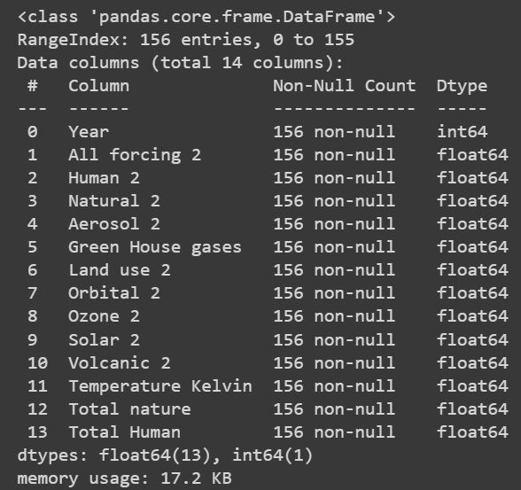
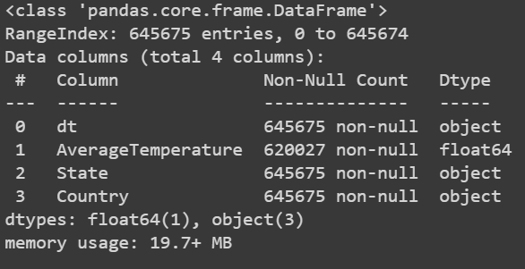
Data Source and structure
Berkley earth (An independent US non-profit organization focused on environmental data science
https://www.kaggle.com/datasets/berkeleyearth/climate-change-earth-surface-temperature-data/code
Files – Global temperatures
By state
By country
Intergovernmental Panel on Climate change(IPCC) - A united nations body for assessing the science related to climate change
https://www.ipcc.ch/data/
Files – Change in natural and human factors with respect to temperature changes

Slide 5
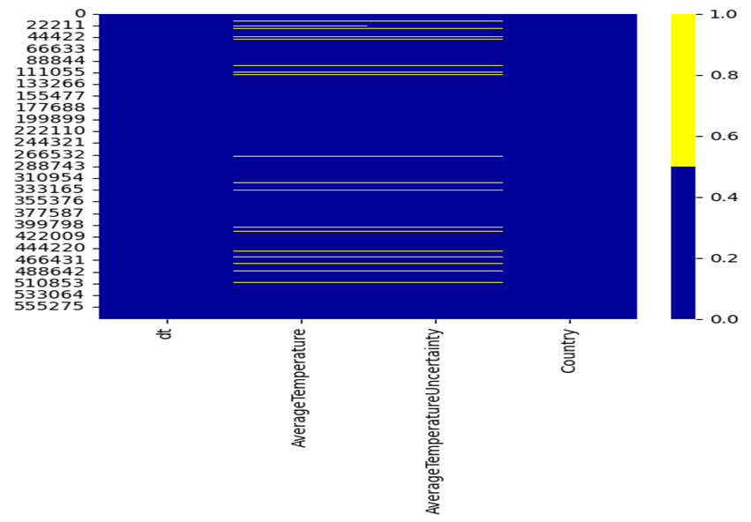
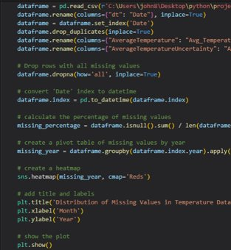
Data Before Cleaning
Heat map represents the missing values in the dataset
Cleaning Steps
Removing duplicate data
Forward filling ( Average Temperature)
Rename the column name

Slide 6
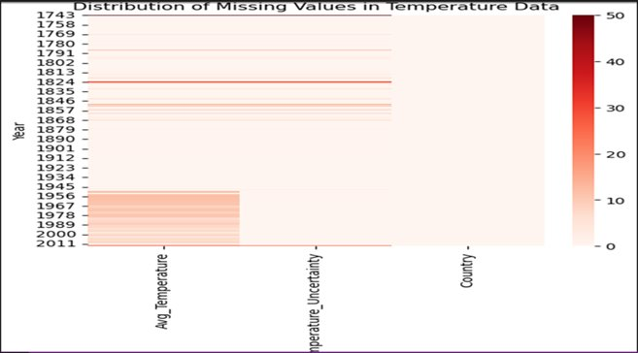
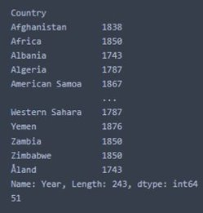
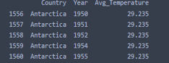
Pre-processing Steps
Grouping by year
Grouping by Country
Cleaning Steps 2
Acknowledge that starting years vary for each country.
Note that some countries have inconsistent years.
Establish a year range from 1850 to 2011.
Identify any missing years within this range.

Slide 7
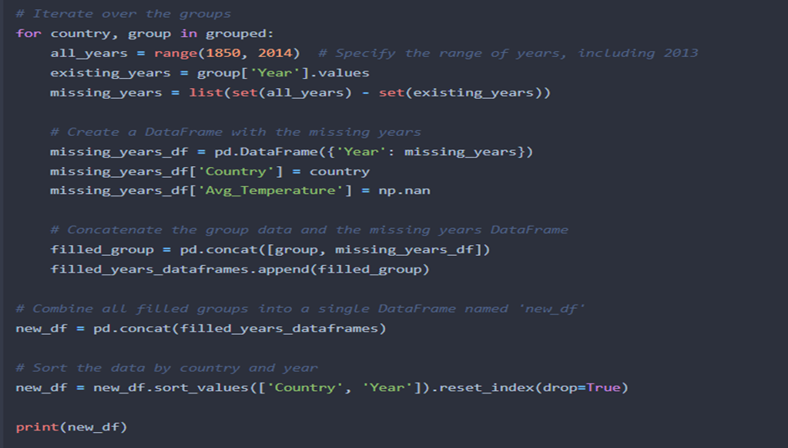
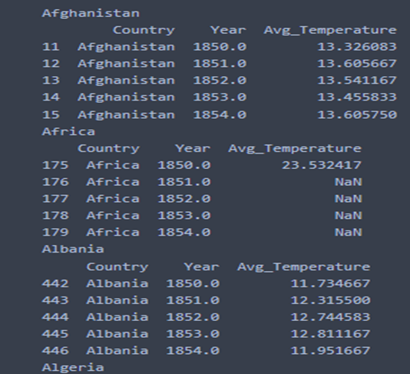

Create a new data frame with missing values for the years 1850 to 2014 and the missing value between the minimum year to 1850.
Concatenate the new data frame to the original dataset.​
Perform a backward fill to complete missing values.​
​Every country have data start from 1850 to 2014

Slide 8
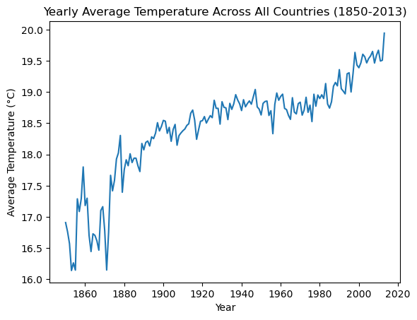
Data Analysis
Global Temperatures for past 150 years
Increase of 2 degree since pre-industrial times (1850-1900)
Significant rise in temperature after 1995 and steep rise in 20th century
Industrial revolution has been a major impact for the rise in temperature

Slide 9
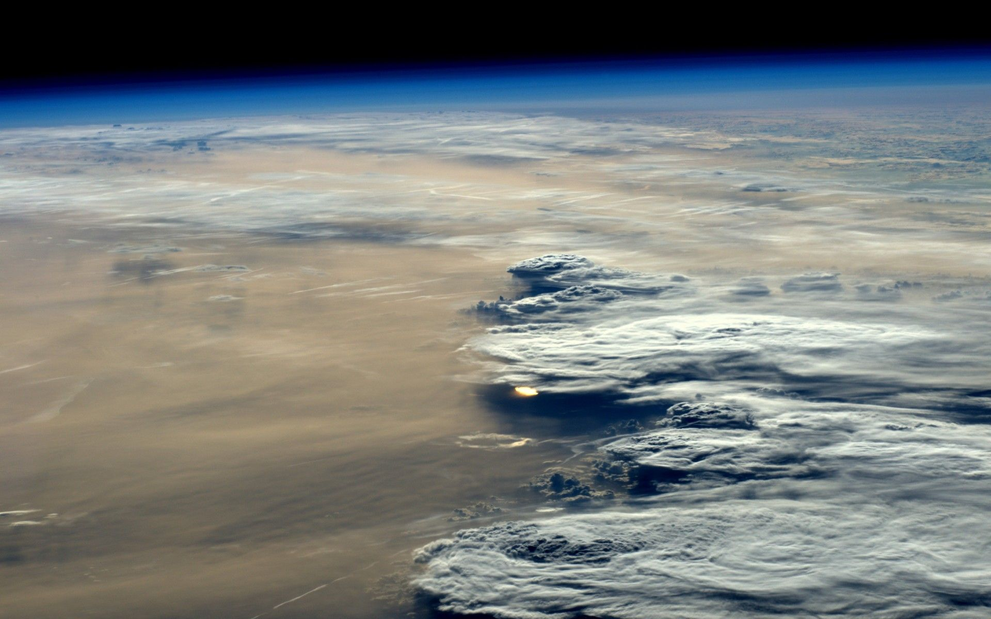
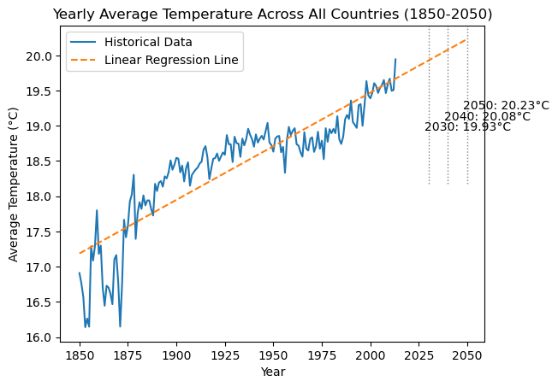
Data Forecasting
Method- linear regression with python
Determine yearly averages per country and overall, filter data post-1849, create a linear regression model, and predict temperatures for the next 30 years.
Results -
2030 will experience average temperature of 19.93 degree Celsius
2050 will be the warmest year of all time
A significant 3 degree rise till 2050 means the coastline will be disappeared, extreme droughts, extreme weather

Slide 10

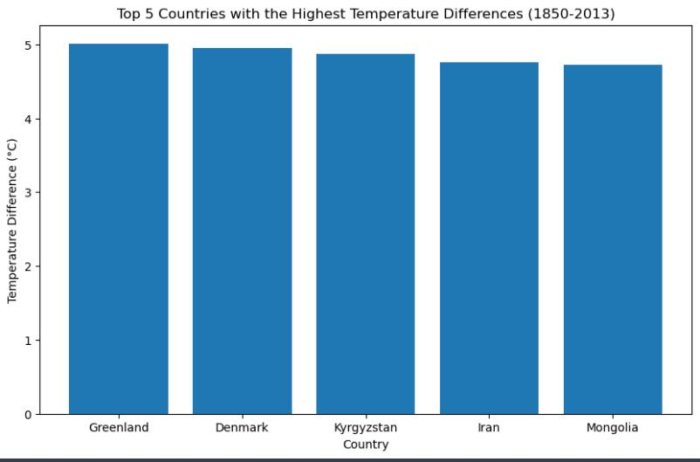
Top 5 countries With highest temperature difference
Temperature rise and difference in countries
Global land temperatures by country dataset
Calculated temperature difference in all 243countries
Using matplotlib plotted top 5 country's temperature difference
Results
Greenland underwent a significant temperature rise
Countries in North undergo a higher temperature change

Slide 11
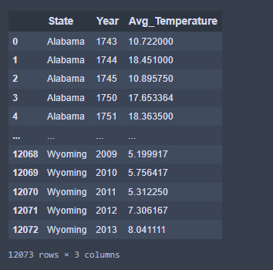
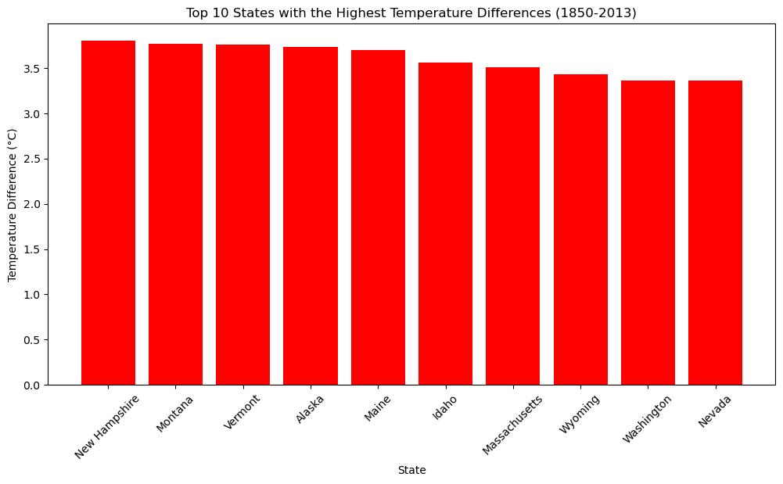
United States of America
Subset analysis
Temperature rise and difference in United States of America
Dataset - Global land temperatures by States
Subset of United states of America by group by function
Calculated temperature difference in all 50 states
Using matplotlib plotted top 10 states temperature difference
Results
New Hampshire experienced the most temperature difference since 1850
Northern states have a significant temperature difference
Alaska to be one of the top 10 states undergoing

Slide 12

Major Finding
Global land temperatures have risen of about 2 degree Celsius
Melting of glaciers in Alaska is because of increase in surface temperatures
July to be the warmest months of all months since 1850 and will continue to be
Winters will not more be colder
Natural factors have equal to none to do with climate change
Human factors hugely impact climate change
Green house to be the main reason for increase in temperature
If this trend continues the past pattern, earth will experience extreme weather like hurricane, floods and droughts

Slide 13

WHAT DO WE DO ABOUT IT

